Slide 1
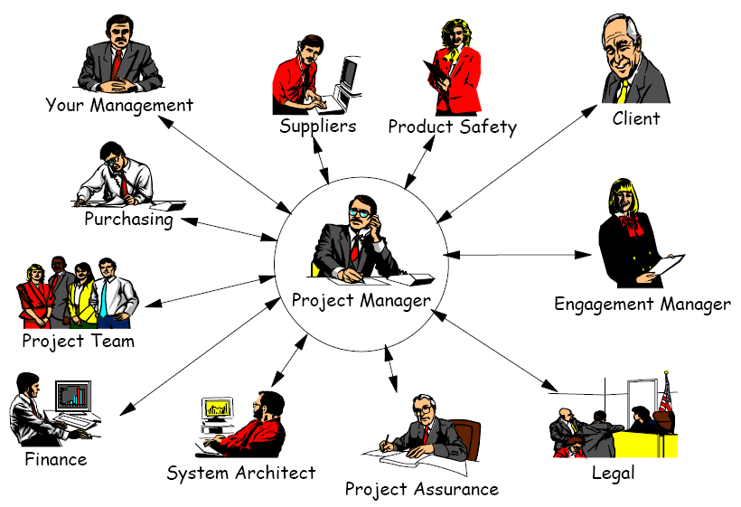
Project Manager - SPOC

Slide 2
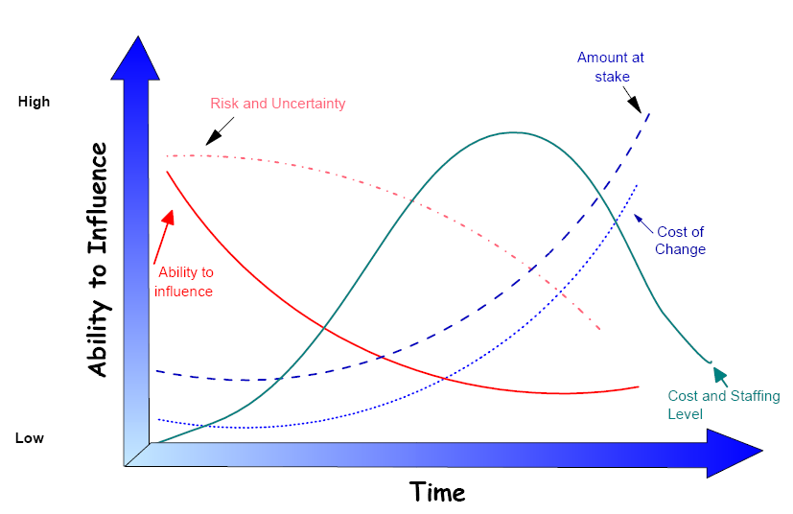
Characteristics of Project Lifecycle

Slide 3
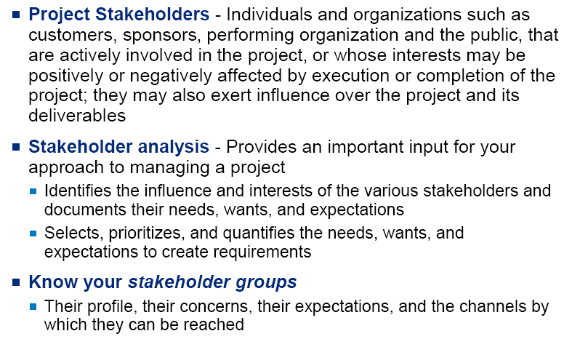
Project Stakeholders

Slide 4
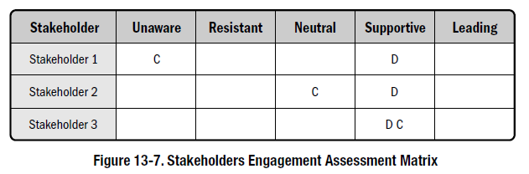
Project Stakeholder Assessment Matrix
The engagement level of the stakeholders can be classified as follows:
Unaware. Unaware of project and potential impacts.
Resistant. Aware of project and potential impacts and resistant to change.
Neutral. Aware of project yet neither supportive nor resistant.
Supportive. Aware of project and potential impacts and supportive to change.
Leading. Aware of project and potential impacts and actively engaged in ensuring the project is a success.
C: Current D: Desired

Slide 5
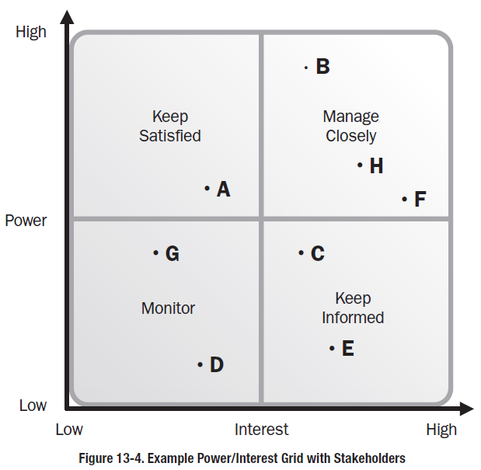
Project Stakeholder Assessment Grid

Slide 6
Stakeholder Analysis
Active Challenger
Has influence, but doesn’t support
Enthusiast
Has influence & does support
Frank
Sue
Jen
Level of influence over other stakeholders
Passive Challenger
Little influence, but doesn’t support
Follower
Can’t influence, yet does support
Mary
Glen
John
Harry
Level of support for the goal
High
Priority
Medium
Priority
Low
Priority

